Slide 1
Introduction of Information Server 8.5/8.7
Any use, copying or distribution without written permission from UnitedHealth Group is prohibited.

Slide 2
Purpose And Agenda
Purpose
This presentation will provide an overview of Info sphere 8.5/8.7 Architecture that is used by Datastage and other Info sphere tools such as Quality stage, Information analyzer etc.
Agenda
What is IBM InfoSphere Information Server (IIS) 8.5/8.7, its components and the different versions used in UHG?
What is the IBM Infosphere 8.5/8.7 Architecture?
Discussion on InfoSphere 8.5/8.7 Architecture versus previous versions.
What are the different hosts used by Info sphere 8 and how do we interact with datastage using a command line interface?
Question and Answers
Any use, copying or distribution without written permission from UnitedHealth Group is prohibited.

Slide 3
About IBM Info Sphere Information Server 8.5/8.7
IBM InfoSphere Information Server – A software platform that cleanses, transforms, and moves information consistently and securely throughout the enterprise
IBM InfoSphere DataStage is a part of IBM Information Server Suit.
IBM InfoSphere Information Server/DataStage follows a client-server architecture
The client components are used for designing, monitoring and administration activities.
IBM InfoSphere Information Server 8.5 is installed in layers that are mapped to the physical hardware. It utilizes the below 4 tiers:
  Client Tier
  Service Tier
  Metadata repository Tier
  Engine Tier
Currently we have Information server v8.5 at UHG and plans are to upgrade to version 8.7
Any use, copying or distribution without written permission from UnitedHealth Group is prohibited.

Slide 4
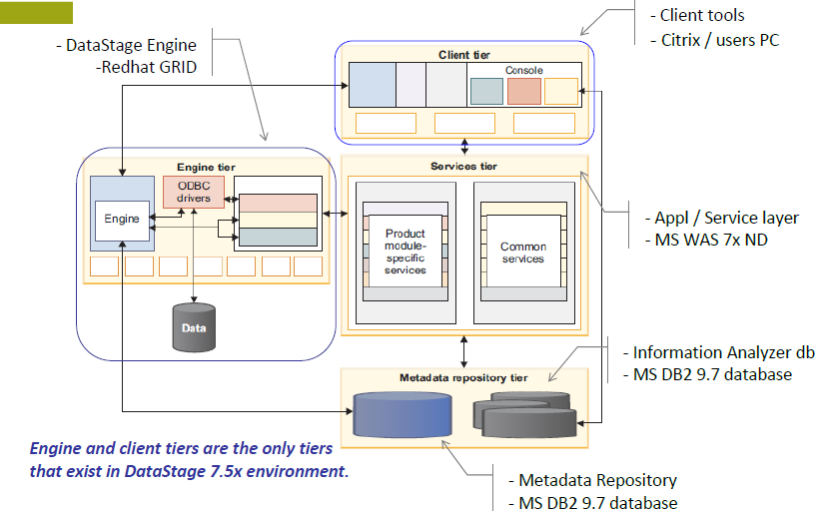
IBM InfoSphere Information Server Architecture
Any use, copying or distribution without written permission from UnitedHealth Group is prohibited.

Slide 5
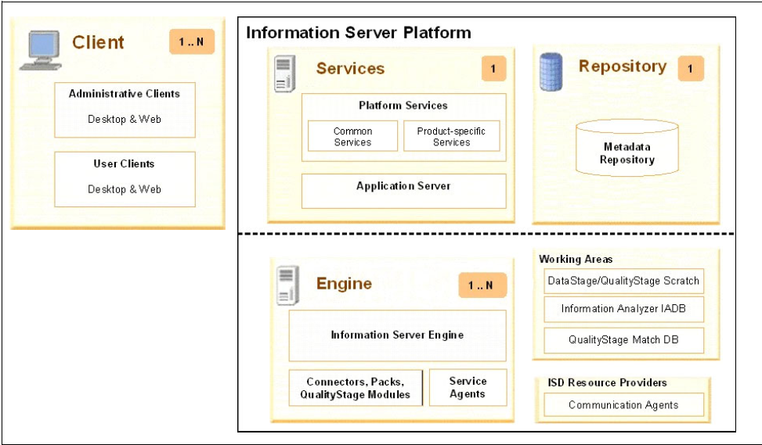

IBM Info Sphere Information Server Architecture Tires
Any use, copying or distribution without written permission from UnitedHealth Group is prohibited.

Slide 6
The four Tiers
Client Tier: This tier consists of product module clients that are not Web-based and that are used for development and administration in IBM InfoSphere Information Server. The clients are Designer, Director and Administrator.
Services Tier: This tier has common (design, metadata & execution) and product-specific services for IBM InfoSphere Information Server.
Metadata repository Tier: This is the database that stores the shared metadata, data, and configuration for IBM InfoSphere Information Server and the product modules.
Engine Tier: This tier has the runtime engine that runs jobs and other tasks for product modules that require the engine.
Any use, copying or distribution without written permission from UnitedHealth Group is prohibited.

Slide 7
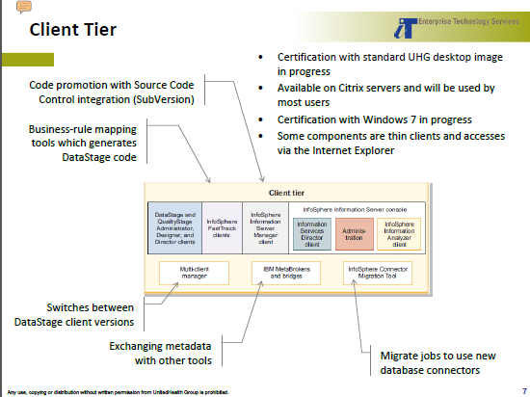
CLIENT TIRE
Any use, copying or distribution without written permission from UnitedHealth Group is prohibited.

Slide 8
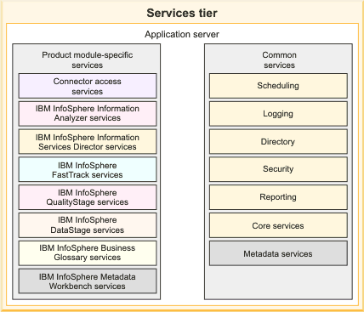
SERVICES TIRE
Any use, copying or distribution without written permission from UnitedHealth Group is prohibited.

Slide 9
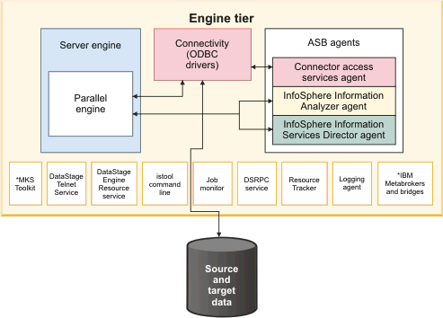
ENGINE TIRE
Any use, copying or distribution without written permission from UnitedHealth Group is prohibited.

Slide 10
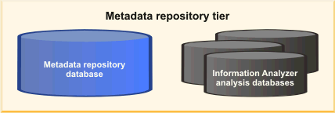
METADATA REPOSITORY
The metadata repository tier includes the metadata repository for IBM InfoSphere Information Server. This database is a shared component that stores design-time, runtime, glossary, and other metadata for product modules in the InfoSphere Information Server suite.
If Info Sphere Information Analyzer is installed, the metadata repository also includes one or more analysis databases. The analysis databases are used by Info Sphere Information Analyzer when it runs analysis jobs
Any use, copying or distribution without written permission from UnitedHealth Group is prohibited.

Slide 11
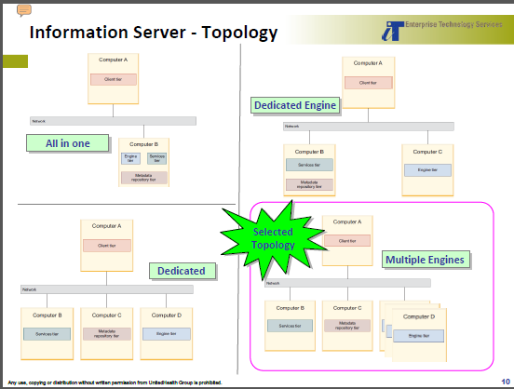
Any use, copying or distribution without written permission from UnitedHealth Group is prohibited.

Slide 12
Info Sphere Information Server unified platform components
Any use, copying or distribution without written permission from UnitedHealth Group is prohibited.

Slide 13
InfoSphere DataStage V8.5
Data stage is one of the GUI based ETL tool which is used to create usable data warehouse and data mart applications.
Data stage has multiple jobs
1.server jobs
2.parallel jobs
3.Mainframe Jobs
4.Sequencer Jobs
Any use, copying or distribution without written permission from UnitedHealth Group is prohibited.

Slide 14
What is IBM Info Sphere Quality Stage
IBM Info sphere Quality Stage is a tool intended to deliver high quality data required for success in a range of enterprise initiatives including business intelligence, legacy consolidation and master data management.
It does this primarily by identifying components of data that may be in columns or free format, standardizing the values and formats of those data,using the standardized results and other generated values to determine likely duplicate records, and building a “best of breed” record out of these sets of potential duplicates

Slide 15
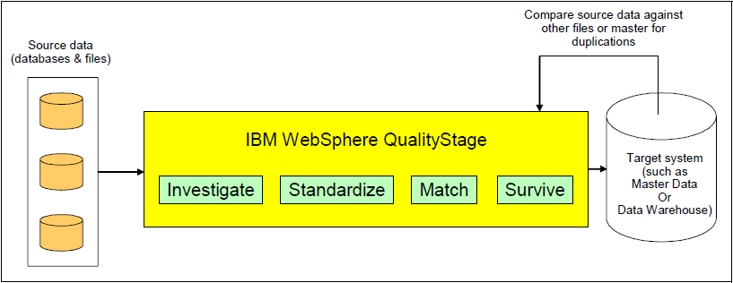
QUALITYSTAGE PROCESS OVERVIEW

Slide 16

Info sphere Quality Stage Typical Scenario
Multiple databases and files
Compare source data against other files or master for duplications
Compare
Master Data
or
Data Warehouse
Info sphere Quality Stage
Load unique data and discard duplicates
Source data
Notes:
IBM Confidential

Slide 17
Data Quality Challenges
Different or inconsistent standards in structure, format or values
Missing data, default values
Spelling errors, data in wrong fields
Buried information
Data myopia
Data anomalies

Slide 18
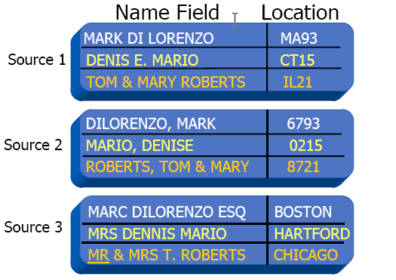
Different or Inconsistent Standards

Slide 19
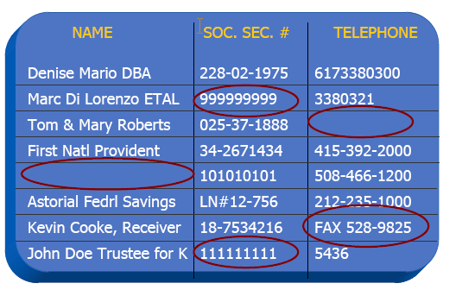
Missing Data & Default Values

Slide 20
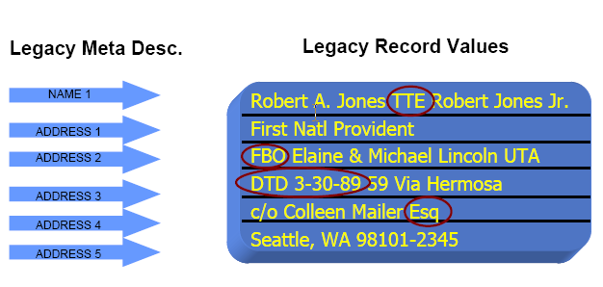
Buried Information

Slide 21
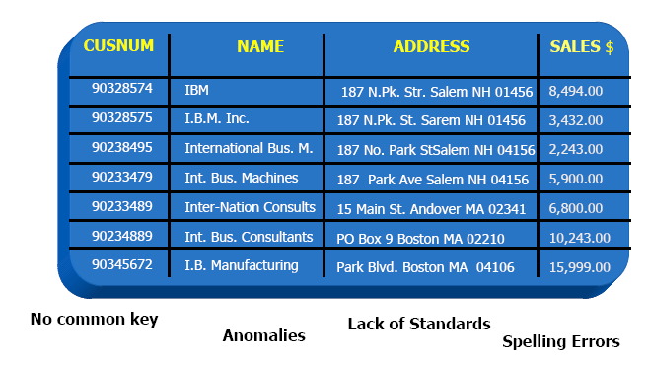
The Anomalies Nightmare

Slide 22
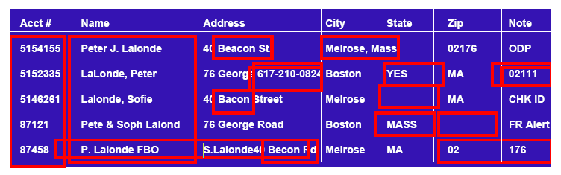
What data challenges do you face?

Slide 23
QualityStage Basics
Ascential QualityStage helps you manage and maintain data quality
so that your company can rely upon its corporate data investment.
Helps organizations produce high-quality data as well as lower the
cost of data management.
IBM Quality Stage is a comprehensive development environment for developing applications that re-engineer data.
The aim of such an application is to deliver data that meets business requirements and successfully addresses business goals.
Data that is restructured to meet the new requirements is called re-engineered data.
Notes:
IBM Confidential
A re-engineering application caters to the following
Resolve conflicting and ambiguous meaning of data values.
Brings to surface important data hidden in free form text fields.
Standardizes data conforming to industry standards and government standards.
Creates a a unique view of a business unity.

Slide 24
QUALITYSTAGE STAGES
INVESTIGATE STAGE
STANDARDIZE STAGE
MNS STAGE
WAVES STAGE
AVI STAGE
MATCH FREQUENCY STAGE
UNDUPLICATE STAGE
REFERENCE MATCH STAGE
STANDARDIZE QUALITY ASSESMENT
SURVIVE STAGE
Any use, copying or distribution without written permission from UnitedHealth Group is prohibited.

Slide 25
IBM Info Sphere Information Analyzer
Data Profiling
You use data profiling and analysis to understand your data and ensure that it suits the integration task. Information Analyzer is a critical component of IBM Info Sphere Information Server that profiles and analyzes data so that you can deliver trusted information to your users.
Info Sphere Information Analyzer can automatically scan samples of your data to determine their quality and structure. This analysis aids you in understanding the inputs to your integration process, ranging from individual fields to high-level data entities. Information analysis also enables you to correct problems with structure or validity before they affect your project.
Any use, copying or distribution without written permission from UnitedHealth Group is prohibited.

Slide 26
IBM Info Sphere Information Analyzer
In many situations, analysis must address data, values, and rules that are best understood by business users. Particularly for comprehensive enterprise resource planning, customer relationship management, or supply chain management packages, validating data against this business knowledge is a critical step. The business knowledge, in turn, forms the basis for ongoing monitoring and auditing of data to ensure validity, accuracy, and compliance with internal standards and industry regulations.
While analysis of source data is a critical first step in any integration project, you must continually monitor the quality of the data. Info Sphere Information Analyzer enables you to treat profiling and analysis as an ongoing process and create business metrics that you can run and track over time.
Any use, copying or distribution without written permission from UnitedHealth Group is prohibited.

Slide 27
Information Analyzer Investigation Functionalities
Column Analysis
Primary Key Analysis
Foreign Key Analysis
Cross Domain Analysis
Publish Analysis Results
Baseline Analysis
Reports
Any use, copying or distribution without written permission from UnitedHealth Group is prohibited.

Slide 28
IBM Info Sphere Fast track
IBM Info Sphere Fast Track automates multiple data integration tasks from analysis to code generation, while incorporating the business perspective and maintaining lineage and documented requirements. Info Sphere Fast Track accelerates the design time to create source-to-target mappings and to automatically generate jobs. Mappings and jobs are then integrated into the metadata repository for IBM InfoSphere Information Server.
Any use, copying or distribution without written permission from UnitedHealth Group is prohibited.

Slide 29
IBM InfoSphere Metadata Workbench
IBM InfoSphere Metadata Workbench provides a visual, Web-based exploration of metadata that is generated, used, and imported by IBM InfoSphere Information Server.
InfoSphere Information Server components store design time, runtime, and glossary metadata in the metadata repository. Users can also import database and data file information into the metadata repository and create extended data sources and extension mappings that represent objects and processes that exist outside of InfoSphere Information Server.
InfoSphere Metadata Workbench helps business and IT users explore and manage those metadata assets. The metadata workbench gives you reports on data flow, data lineage, and the impact of changes to data assets or physical assets.
Any use, copying or distribution without written permission from UnitedHealth Group is prohibited.

Slide 30
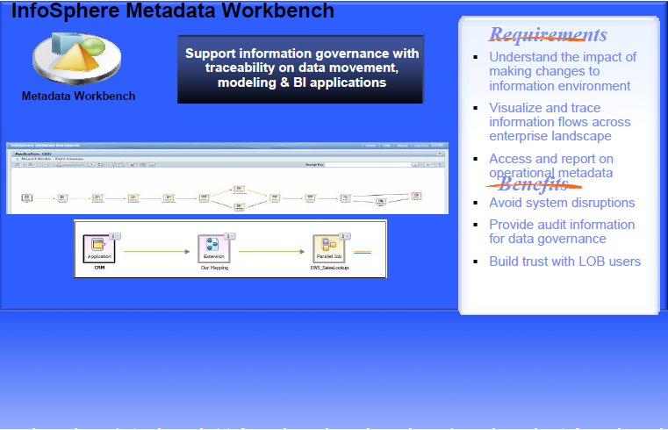
IBM InfoSphere Metadata Workbench
Any use, copying or distribution without written permission from UnitedHealth Group is prohibited.

Slide 31
InfoSphere Business Glossary
IBM InfoSphere Business Glossary is an interactive, Web-based tool that enables users to create, manage, and share an enterprise vocabulary and classification system. A business glossary is designed to help users understand business language and the business meaning of information assets like databases, jobs, database tables and columns, and business intelligence reports. In addition to categories and terms, the business glossary also contains information about other assets such as database tables, jobs, and reports that are in the metadata repository.
Any use, copying or distribution without written permission from UnitedHealth Group is prohibited.

Slide 32
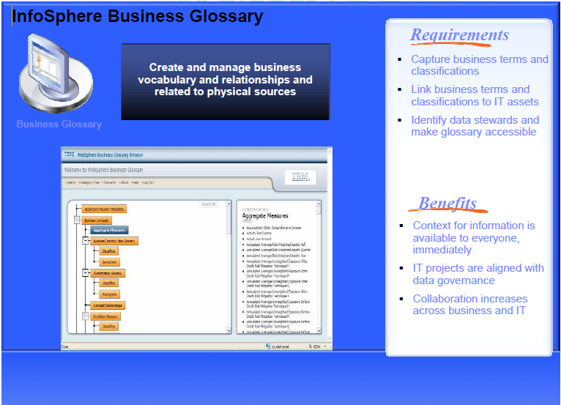
InfoSphere Business Glossary
Any use, copying or distribution without written permission from UnitedHealth Group is prohibited.

Slide 33
IBM InfoSphere Information Services Director
IBM InfoSphere Information Services Director provides a unified and consistent way to publish and manage shared information services. Using InfoSphere Information Services Director, information specialists can design and deploy reusable information integration tasks including data cleansing, data transformation, and data federation services.
You can more easily create business processes with information from a complex, heterogeneous environment if that information is published as consistent and reusable services.
Any use, copying or distribution without written permission from UnitedHealth Group is prohibited.

Slide 34
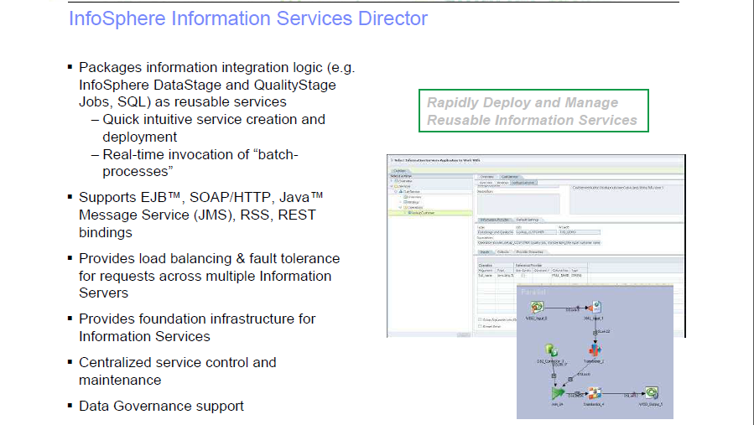
Any use, copying or distribution without written permission from UnitedHealth Group is prohibited.

